Slide 1
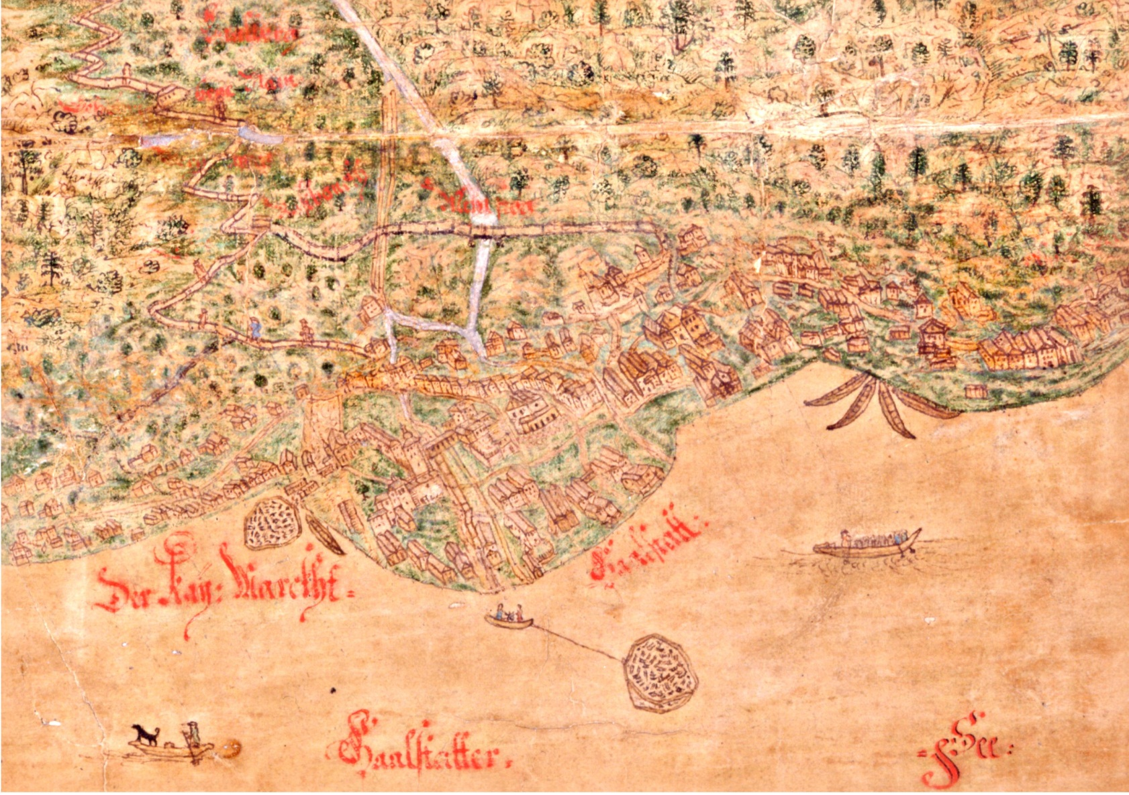
Salt Production in the Austrian Alps
Hallstatt - an earl single factory town

Slide 2
Friedrich Idam → biography → Industrial archeaology
Notes:
2

Slide 3
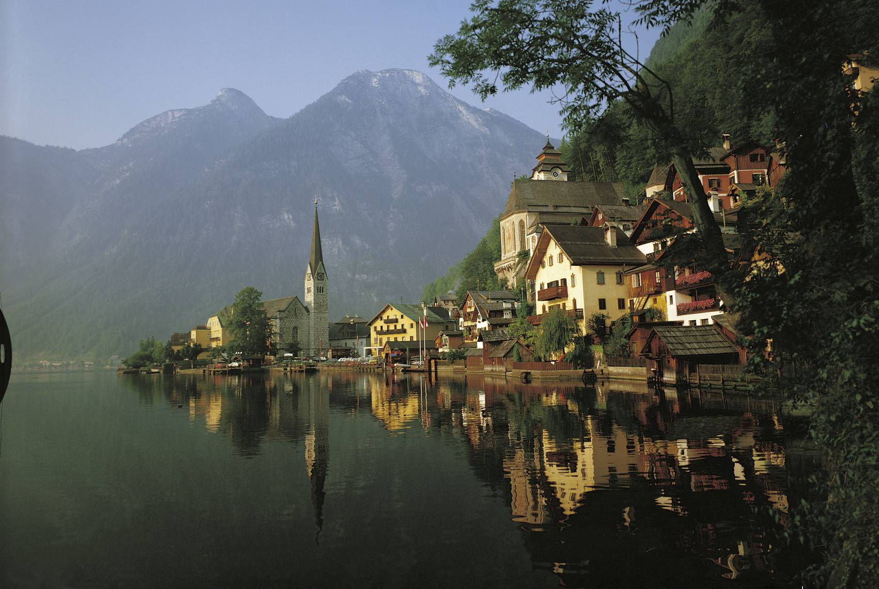
The UNESCO World Cultural Heritage site Hallstatt
Notes:
3

Slide 4
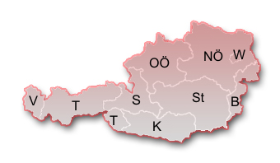
The UNESCO World Cultural Heritage site Hallstatt
Notes:
4

Slide 5
The UNESCO World Cultural Heritage site Hallstatt
Notes:
5

Slide 6
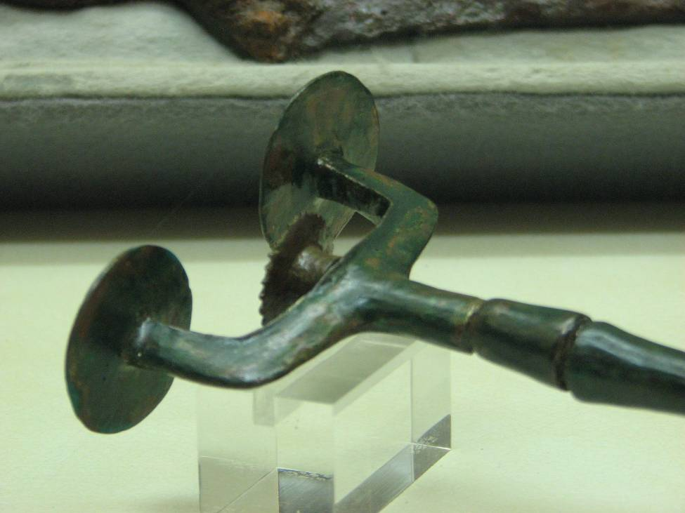
STARTING POINT
In Hallstatt an intensive salt mining industry can be traced back to the middle and Late Bronze Ages by a lot of single and deposit findings.
Notes:
6

Slide 7
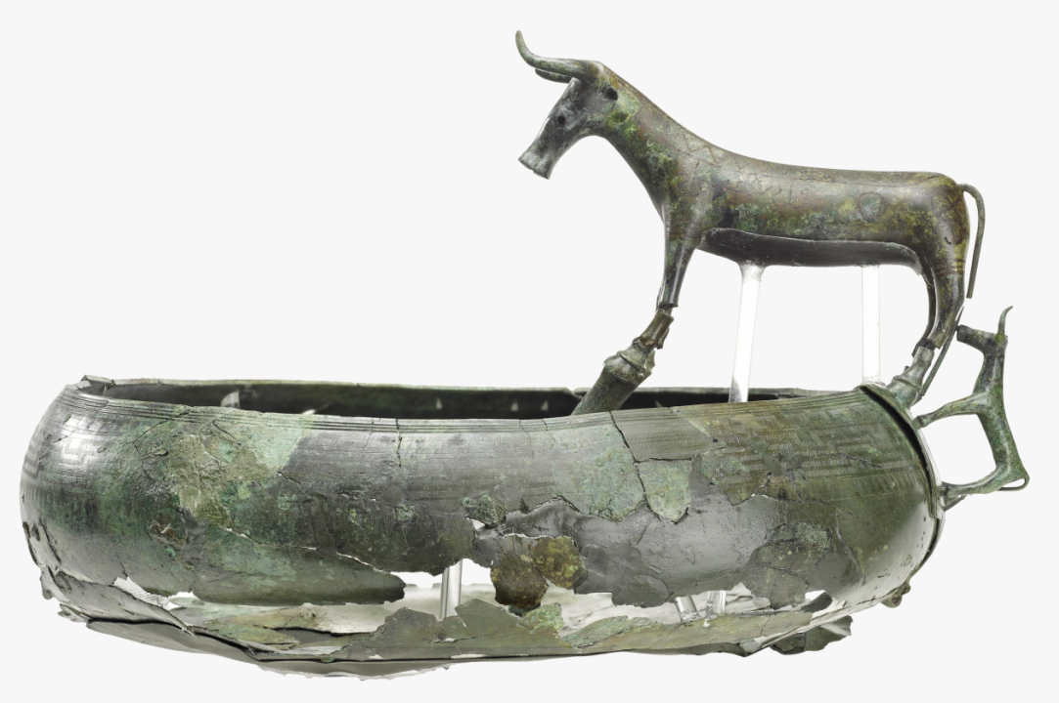
Pre-historical Salt “Industry”
Hallstatt in the Dachstein Mountains of the Austrian Alps is probably best known for its prehistoric cemetery, from which the early Iron Age Hallstatt culture derives its name. This culture means the early Iron Age of Central Europe (ca. 750-475 BC).
Notes:
7

Slide 8
Pre-historical Salt “Industry”
More recent investigations in the salt mine have revealed numerous well-preserved items of the Bronze and Iron Age due to the properties of the salt environment. These included thousands of pinewood chips (for lighting the mine galleries); pieces of woolen textiles; fur and leather caps; leather shoes; and leather carrying baskets (to transport the salt). Other items include ropes and cords made of grass and bast (to pull up larger plates of salt); wooden shovels; and leftovers of food. These varied items provide insight into the methods used in mining.
Notes:
8

Slide 9
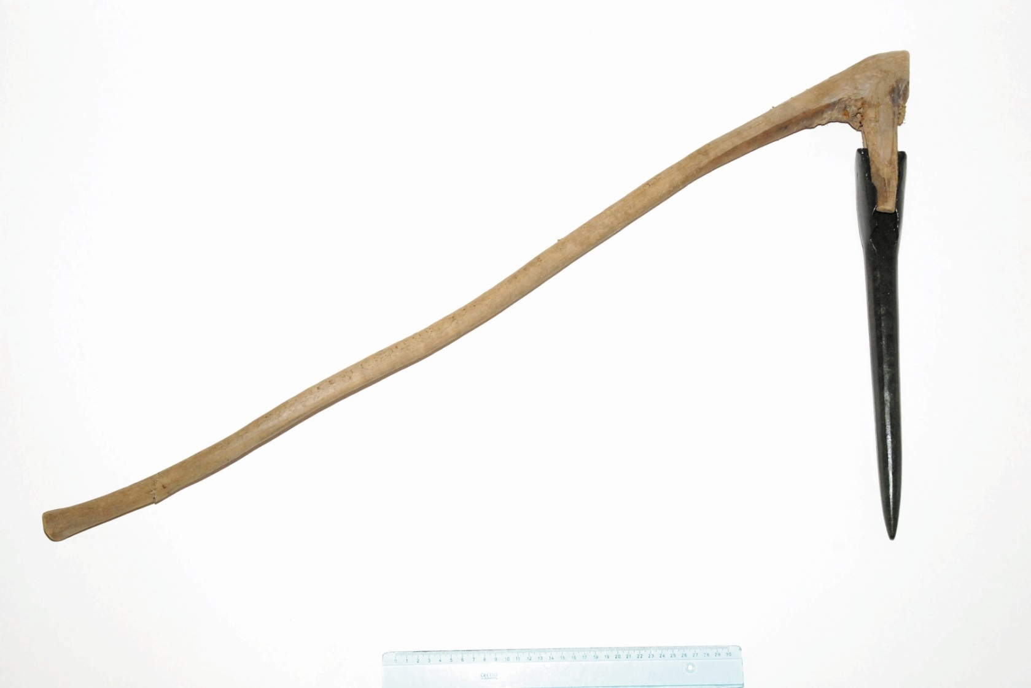
Pre-historical Salt “Industry”
metal picks with a wooden handles
Notes:
9

Slide 10
Pre-historical Salt “Industry”
Recent research carried out by Hans Reschreiter of the Natural History Museum in Vienna has led to the discovery of a large wooden staircase, clearly revealing the skills of Bronze Age carpenters. This is the oldest known staircase in Europe, dating back to the 13th century BC. It consists of spruce and fir trunks, each 20 cm thick, connected by flat and triangular pieces of wood comprising the steps (fig.1). The steps are 1 m wide and carefully fit into slits carved into the trunks. Dendrochronological analysis shows that all the wood in the staircase was cut within the same year.
Notes:
10

Slide 11
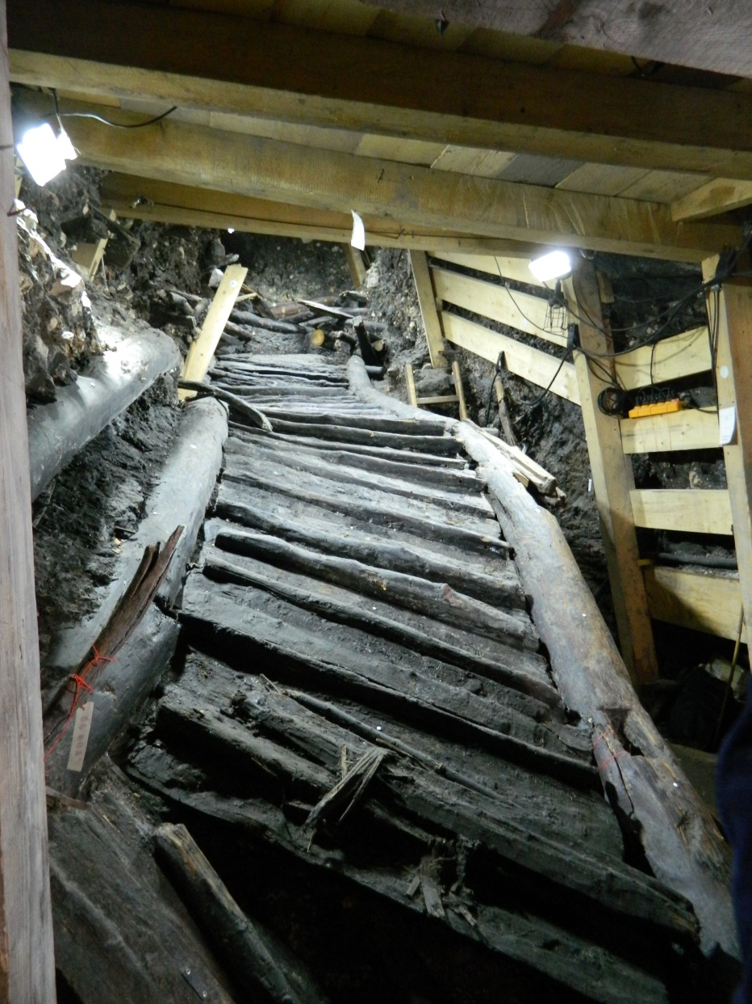
Pre-historical Salt “Industry”
Notes:
11

Slide 12
STARTING POINT
Generally three ways of salt extraction can be distinguished:
1) The extraction of sea salt by drying out the sea water in salt gardens.
2) The mainly prehistorical mining of crystalline rock salt.
3) The extraction of polluted rock salt by dissolving in water in a salt mine and the following drying up of the salty water, the brine.
Notes:
12

Slide 13
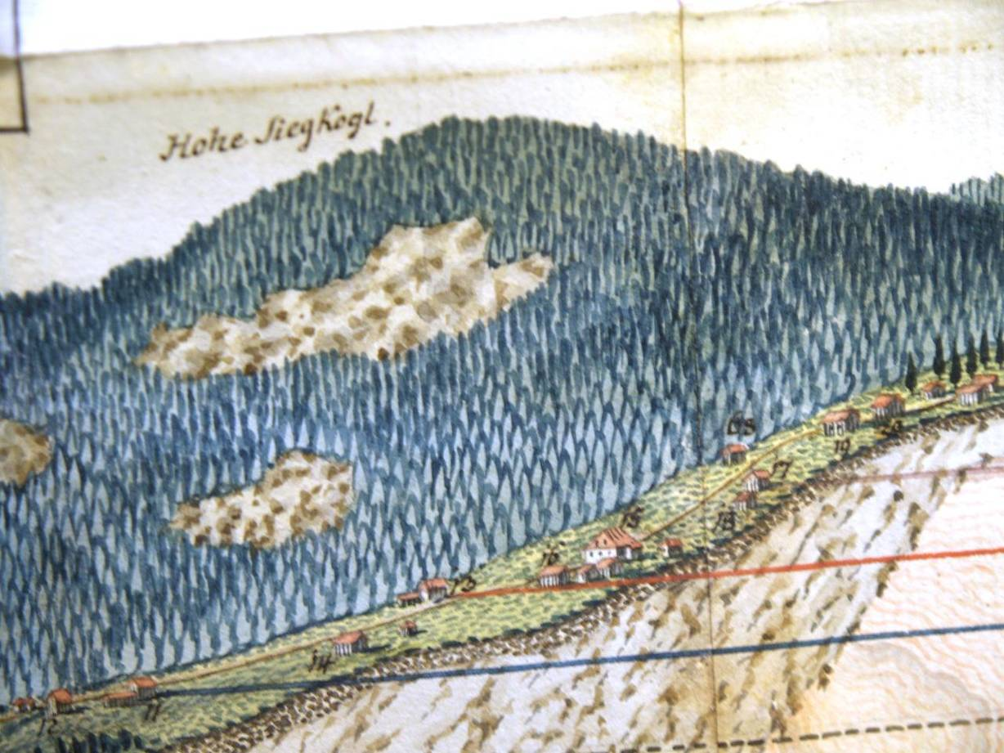
STARTING POINT
The production of brine in the salt mine of Hallstatt has been proved since 1305.
Notes:
13

Slide 14
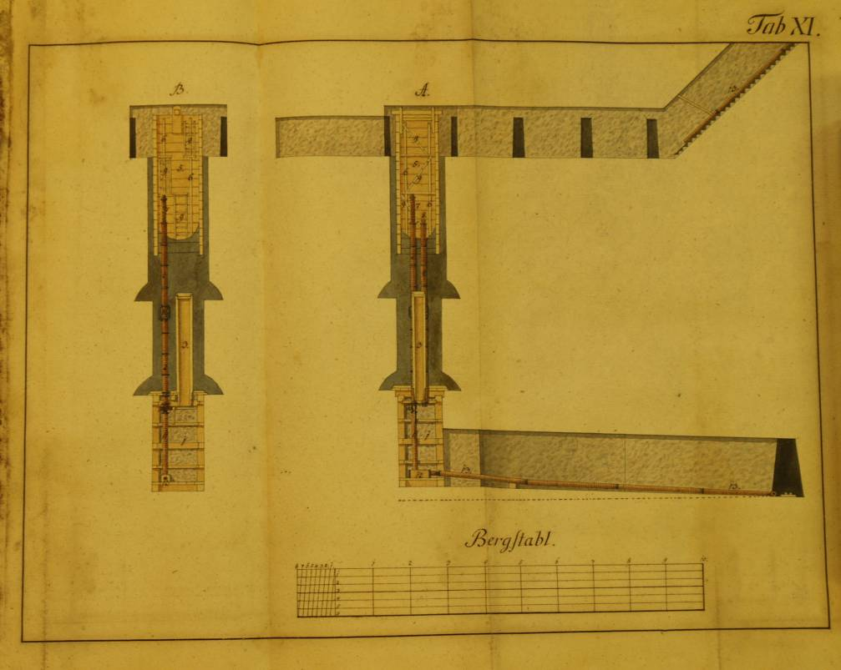
STARTING POINT
The processing of the brine demanded an appropriate concentration of the production facilities, specific forms of manufacturing, organisation, and technology at this very early stage.
Notes:
14

Slide 15
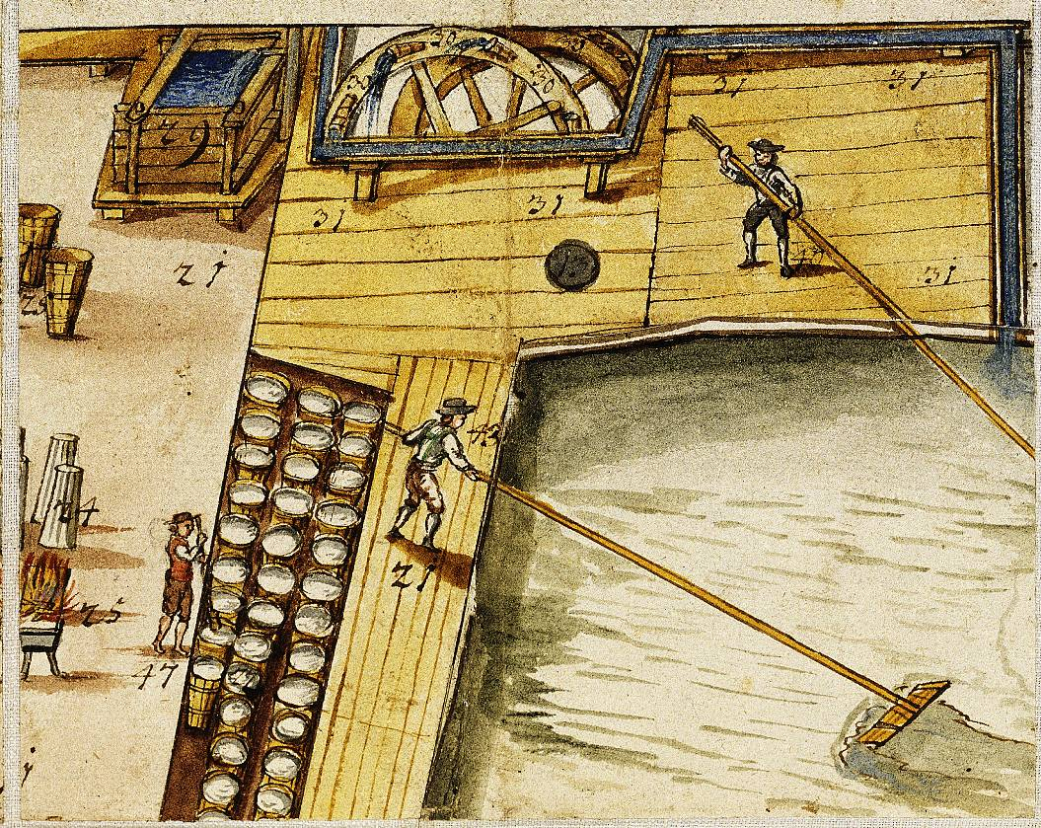
STARTING POINT
Taking into consideration the necessary equipment, the division of labour and the diversity of tasks, the evaporation of the brine is classified as a pre-industrial activity.
Notes:
15

Slide 16
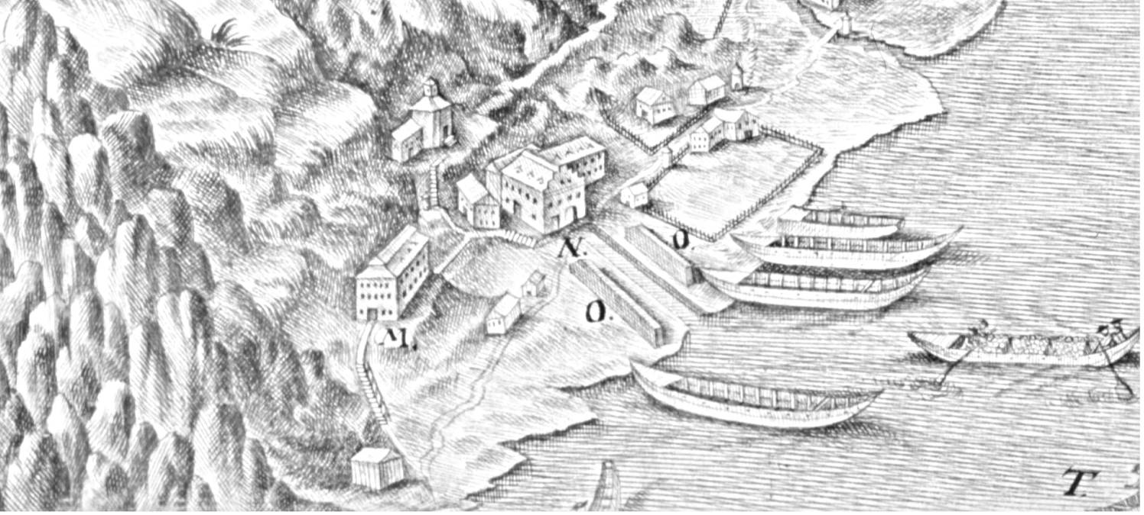
STARTING POINT
Defining a "Single factory Town" as a place where one company structures the entire communal life, Hallstatt could be seen as the European prototype of this form of settlement.
Notes:
16

Slide 17
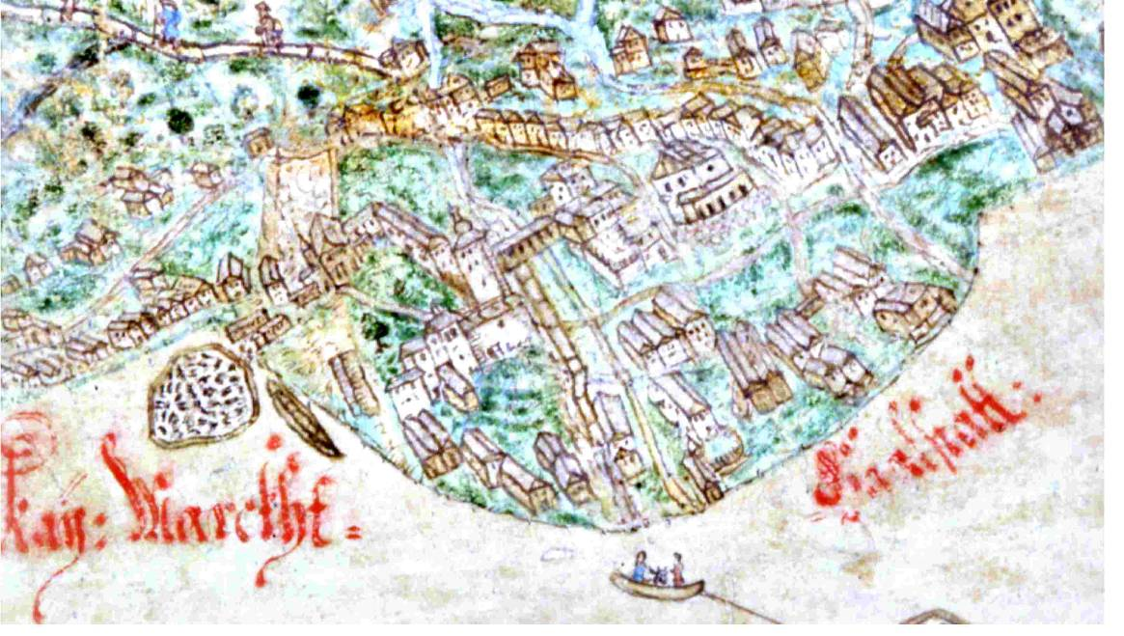
STARTING POINT
The subject of this lecture will focus on the modern times period, putting stress on the urban, the operational and the functional development of Hallstatt. Furthermore I will show that the urban structure of the area is mainly determined by operational necessities.
Notes:
17

Slide 18
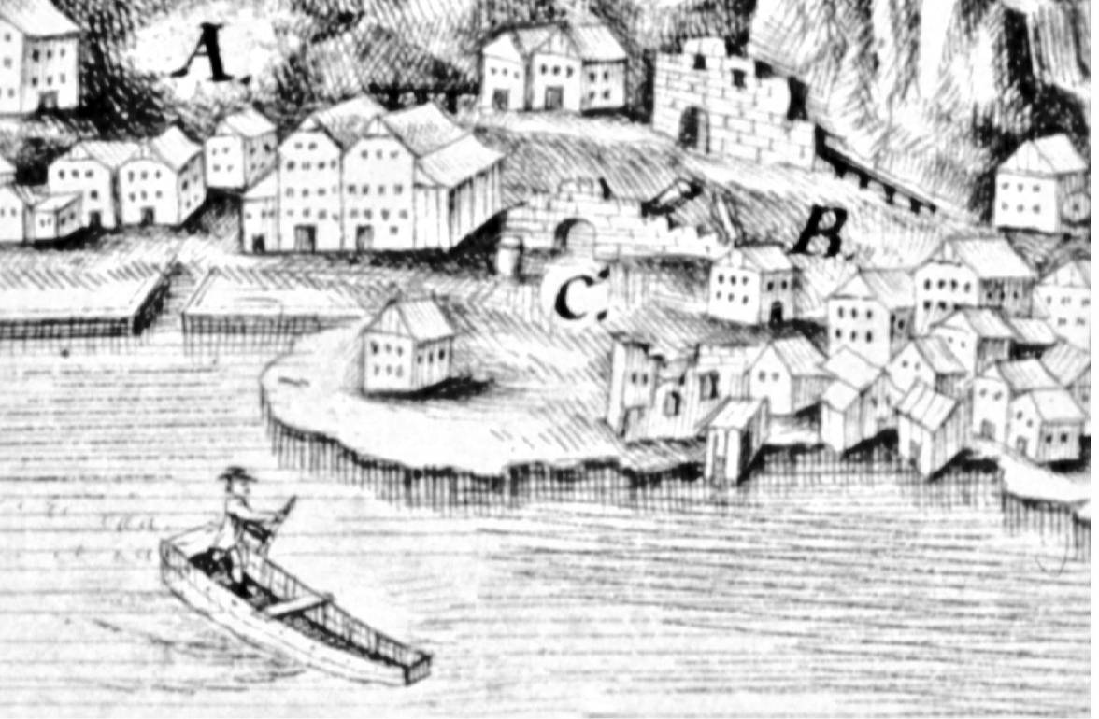
STARTING POINT
The systematically planned medieval foundation of the site was destroyed by a catastrophic fire in 1750.
Notes:
18

Slide 19
STARTING POINT
The reconstruction of the town of Hallstatt after 1750 and the dynamic development of tourism during the 19th century changed the site substantially.
Still, Hallstatt kept its historical importance by maintaining the original shape of the parcels of land. Being a monument of such unique importance, it was classified as a World Cultural Heritage Site in 1997.
Notes:
19

Slide 20
STARTING POINT
Since the middle of the 19th century there has been a continuous declin of the salt production.
Notes:
20

Slide 21
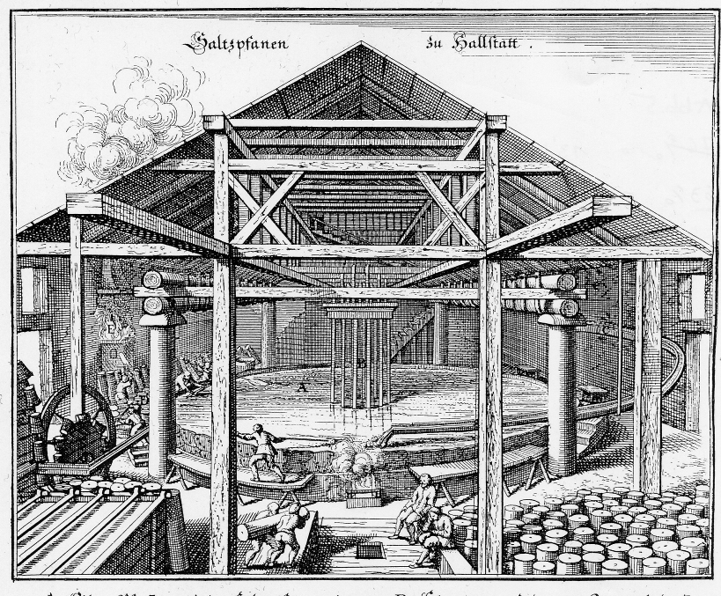
THE "PFANNHAUS" AND THE "PFIESELN"
The "Pfannhaus" or boiling plant is the primary salt production centre. To extract the salt of the brine, that comes from the tunnels, it is necessary to dehydrate it by 75% and to bring the salt to crystallisation.
Notes:
21

Slide 22
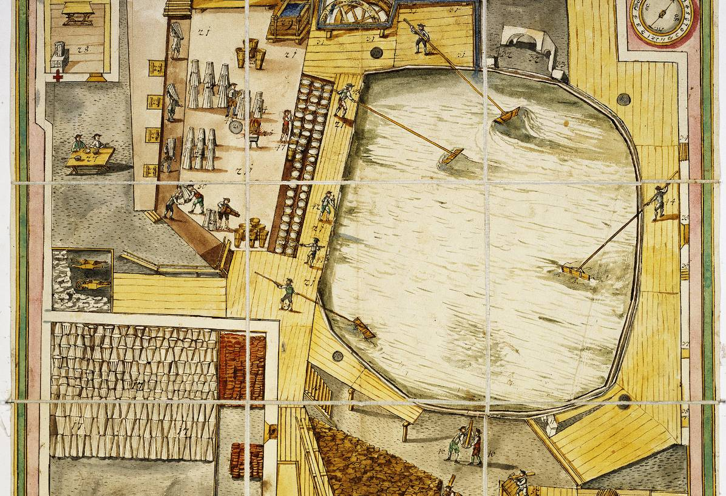
THE "PFANNHAUS" AND THE "PFIESELN"
This process took place in low open basins - the “pans" – They had a smoothly sloping bottom, so that it was possible to collect the salt crystals at the rim and then take them out of the mother salt solution.
Notes:
22

Slide 23
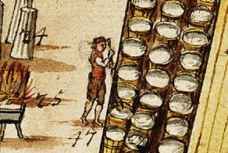
THE "PFANNHAUS" AND THE "PFIESELN"
The next step was to stamp the hot salt in moulds. Those standardised wooden moulds had the form of a cone.
Notes:
23

Slide 24
DISTRIBUTATION
The salt of Hallstatt was distributed on the Danube water way to eastern Austria, to Bohemia and Hungary.
Notes:
24

Slide 25
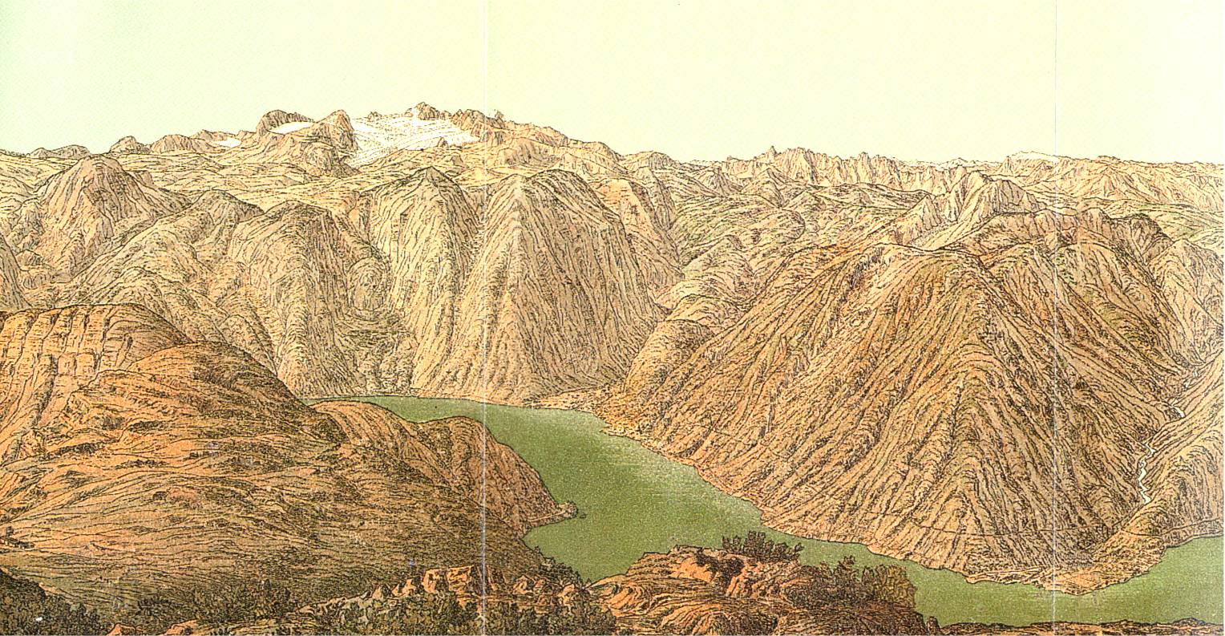
MORPHOLOGY
The historic center of Hallstatt, called “market”, was situated on a piece of alluvial land in form of a cone of about nine hectares. To this day the houses are crowded together next to the steep mountain slopes.
Notes:
25

Slide 26
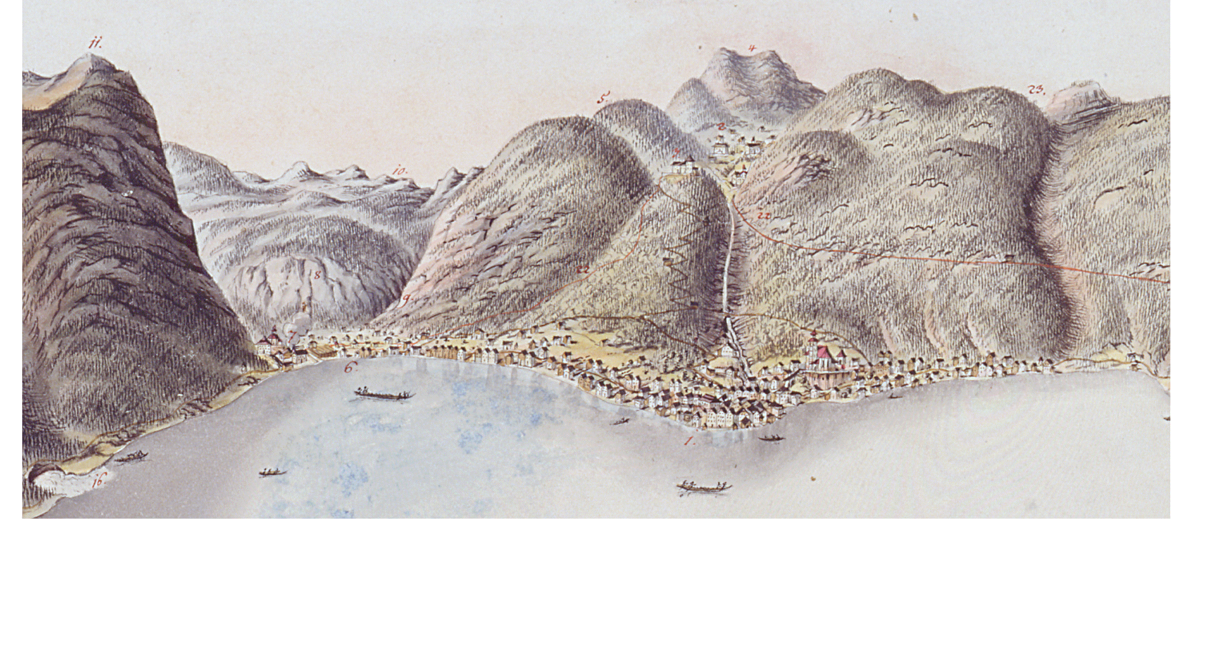
MORPHOLOGY
What is especially remarkable is that since the middle of the 18th century the extension of the built up area in the town has not considerably changed. The dimensional relation of the natural landscape to the cultural landscape has stayed more or less the same.
Notes:
26

Slide 27
MORPHOLOGY
Because of the topological condition even building sites are extremely rare in the town of Hallstatt. "The houses are built so near to the rocks that […] you can step out evenly at the backside of the upper rooms onto the rocks and look down on the lake over the roofs. At some places in Hallstatt there is no other way than going over a sort of bridge that passes over the roofs of the houses."
Notes:
27

Slide 28
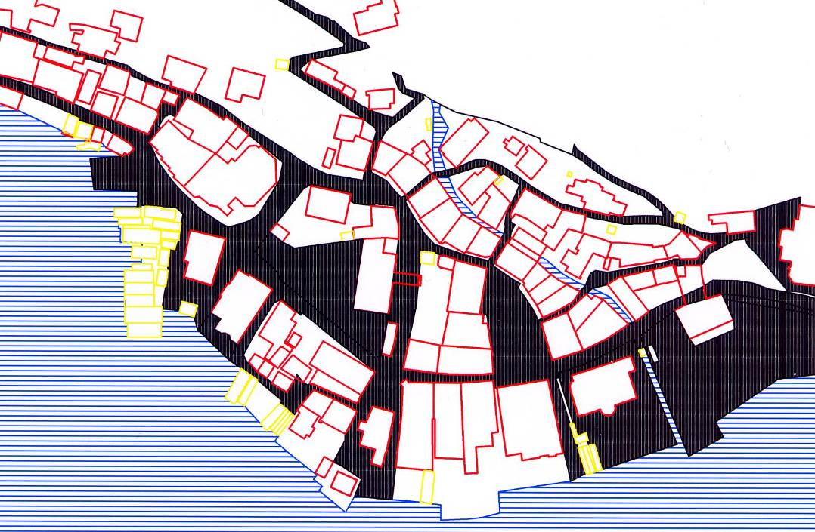
MORPHOLOGY
The accessibility of the town became more and more difficult as more and more traffic was transferred from the water ways to the roads. Even more so because the vertical accessibility is only possible via stairs and small paths.
Notes:
28

Slide 29
MORPHOLOGY
The unique location of the village squeezed between the steep slopes of the Salt-mountain and the lake of Hallstatt, has always made the waterway over the lake the main access. Until the late 19th century all the transport of goods came via the lake.
Notes:
29

Slide 30
THE MEDIVIAL FOUNDATION
The text of the market charter of 1311 talks about a foundation on wild mountains and green meadows. This would mean that at that time the village was founded systematically on the "green meadows". The validity of this interpretation is opposed by a documentary evidence on the salt production in 1305. Already in 1313 salt donations were given to several monasteries and hospitals, which indicates an important salt production right after the founding of the town.
Notes:
30

Slide 31
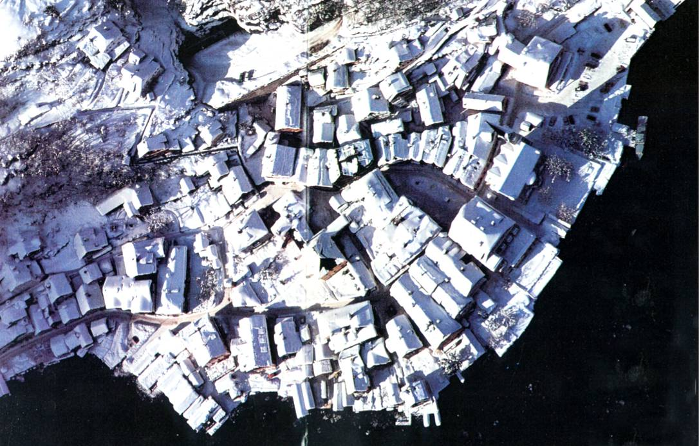
THE MEDIVIAL FOUNDATION
All these indications allow us to conclude that the industrial production place was a systematically planned urban development. These built traces are still can bee seen today.
Notes:
31

Slide 32
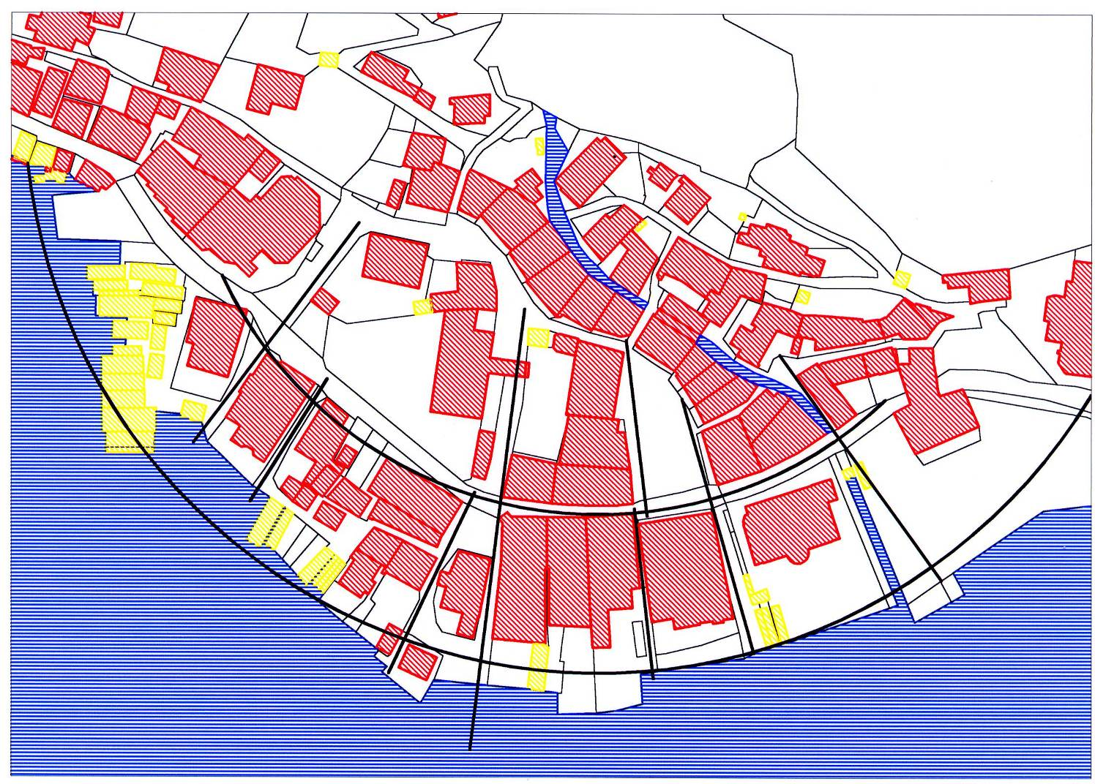
THE MEDIVIAL FOUNDATION
Notes:
32

Slide 33
THE MEDIVIAL FOUNDATION
The knight Nikolaus of Röhrenbach was the technical manager of the salt mining in Hallstatt during the period of the founding. He is one of the few technicians of the middle Ages, who is known by name. Before he came to Hallstatt, he directed the construction of the saltworks in Hall in Tyrol.
Notes:
33

Slide 34
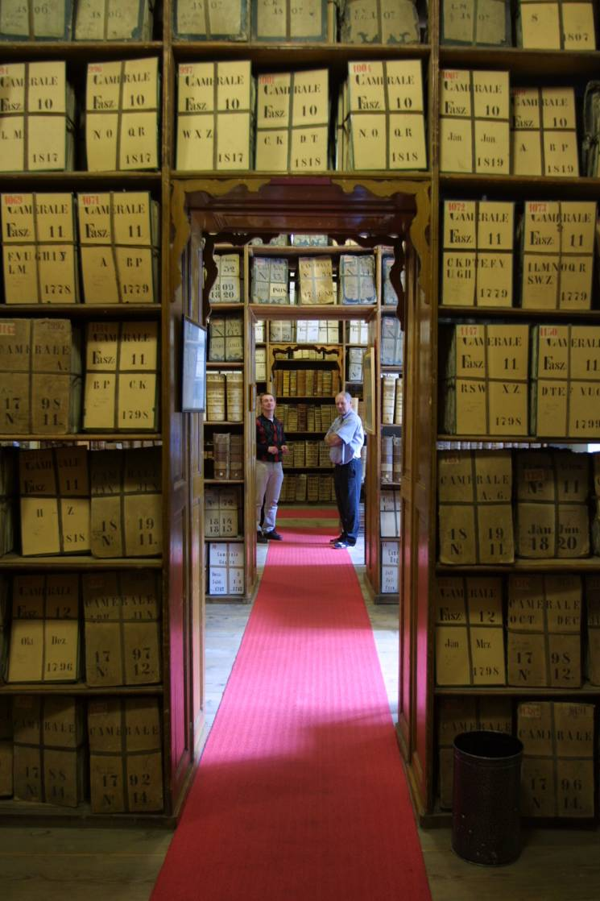
STRUCTURAL PATTERNS
My resarche analyses the patterns of urban development of the town Hallstatt with the help of previously unpublished sources of the archives of the Court-Chamber in Vienna.
Notes:
34

Slide 35
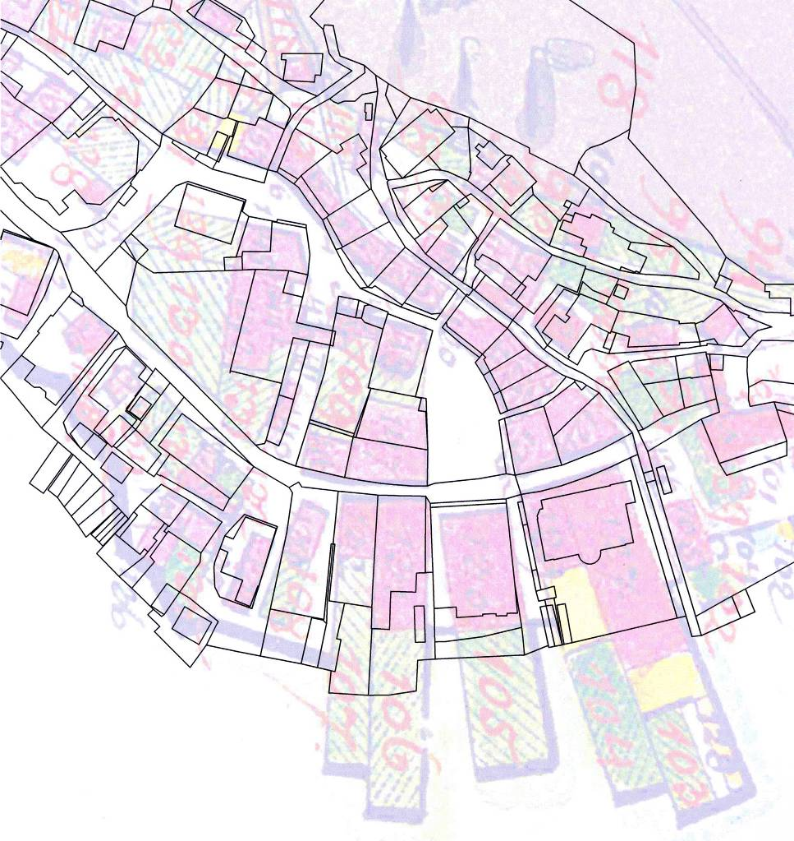
STRUCTURAL PATTERNS
In order to reconstruct the original patterns, a graphical correction of the historic plans was necessary. The original plans were captured digitally and rectified on the basis of still existing landmarks. The structures examined comprise several layers which lie on top of each other, for example boundaries, patterns of paths and ground-plans of buildings.
Notes:
35

Slide 36
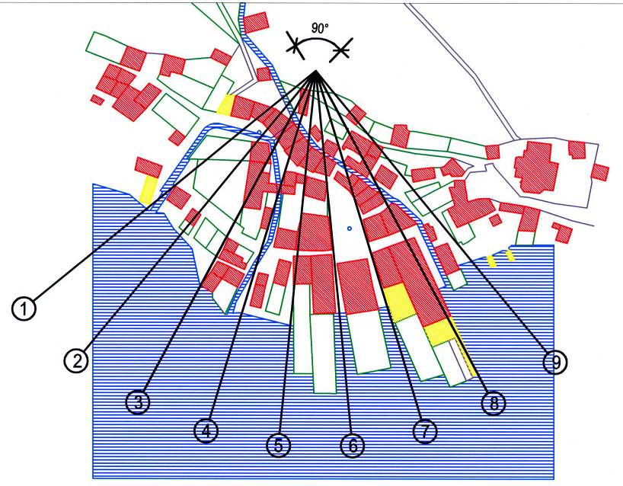
STRUCTURAL PATTERNS
In the course of my research I came across several clues that add up to a general picture. From this a specific conception of urban dating back to the Middle Ages, can be derived. With these facts we have got proof for a structural conception of urban development of a “protoindustrial” production centre for the first time.
Notes:
36

Slide 37
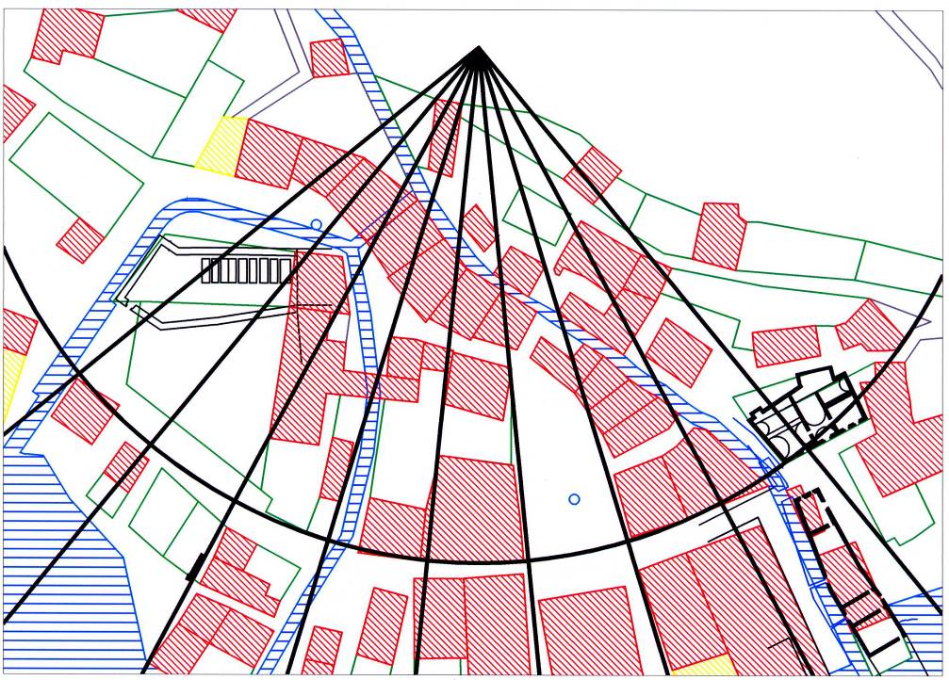
STRUCTURAL PATTERNS
These results also made it possible to localize production plants and public buildings which were destroyed by a fire disaster in the middle of the 18th century in the surviving structures of the village.
Notes:
37

Slide 38
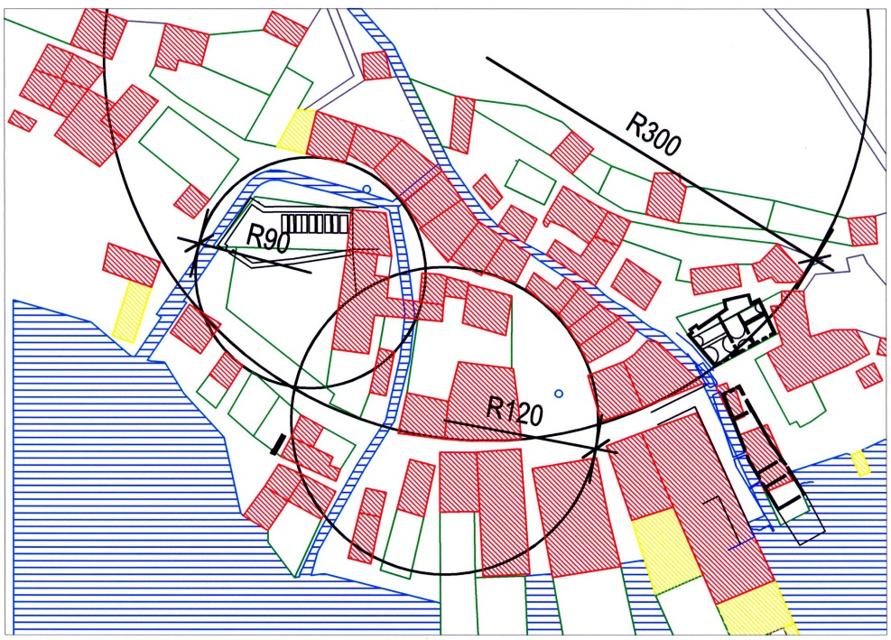
STRUCTURAL PATTERNS
So the structure of the village which seems to have grown organically at first sight is actually founded on geometrical, strictly systematic patterns. By rectifying the historical plans these geometrical patterns could be in their exposed original form.
Notes:
38

Slide 39
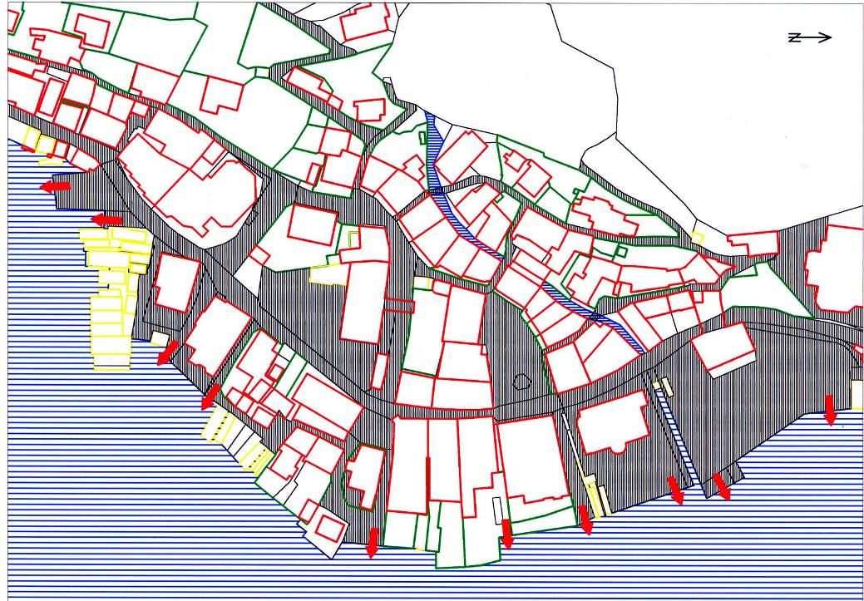
STRUCTURAL PATTERNS
The structure of the paths and docks follows the slope lines and the contour level lines of the alluvial cone. The former main street follows the cone so that the crossing streets are orthogonal to the main street.
Notes:
39

Slide 40
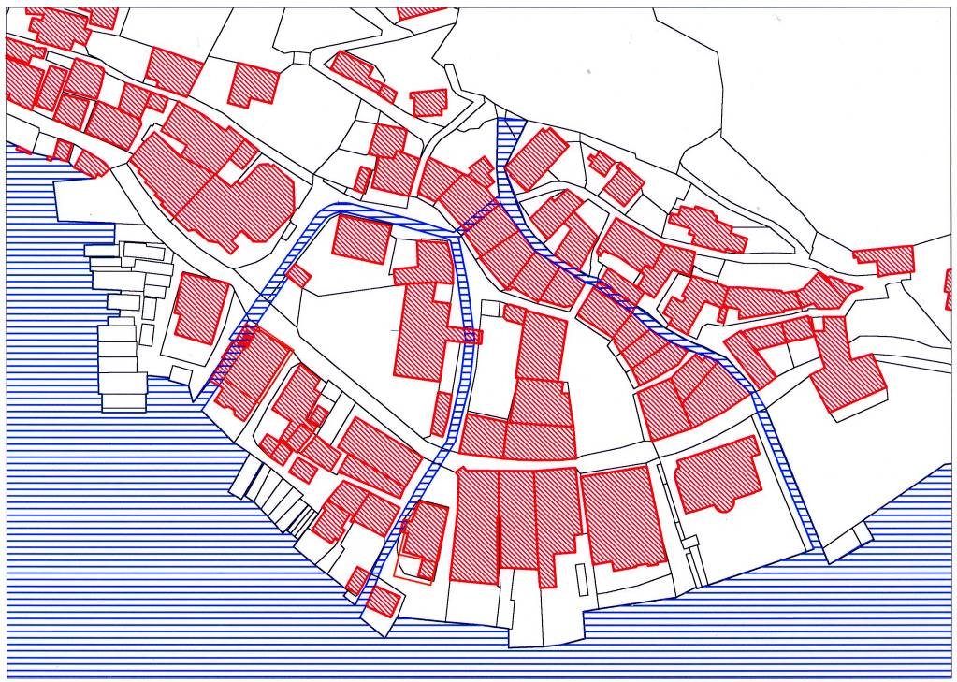
STRUCTURAL PATTERNS
As a result the shapes of the parcels of land are trapeziform and positioned in a way that they do not lay open to the floods and muds of the Mill-brooke that was not regulated before 1888.
Notes:
40

Slide 41
STRUCTURAL PATTERNS
The length of the radius of the circularl main street is exactly 300 “Werkschuh”. A “Werkschuh” is a medival local non-metric linear measure.
These structures are an indication for a systematical urban planning of the town as an industrial production plant in the middle Ages.
Notes:
41

Slide 42
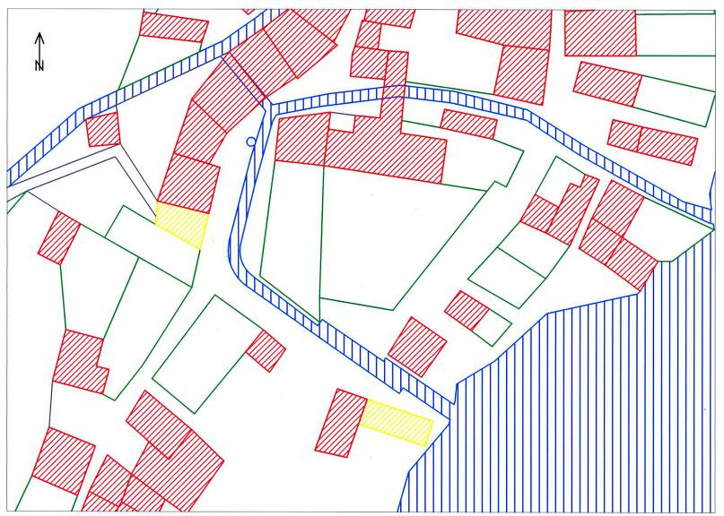
STRUCTURAL PATTERNS
The whole of not yet built-up areas of the boiling plant and parts of the former court form a free space without any pattern. Today this green space is situated between the prehistoric museum, protestant presbytery and the northern part of the lakeside street.
Notes:
42

Slide 43
STRUCTURAL PATTERNS
With this method abstract criteria for structuring, which could be an important basis for future decisions on urban development and architectural interventions, were gained. These patterns can be used for contemporary planning in order to include new objects into the original architectural pattern.
Notes:
43

Slide 44
THE PIPELINE, THE SO CALLED "SULZSTRENN"
At the end of the 16th century the low wood resources in Hallstatt made it impossible to process all the brine in Hallstatt. The construction of a brine pipeline from Hallstatt to Ebensee in the densely wooded region of the Lake Traun was the condition for the construction of the new "Pfannhaus" or boiling house. The "Pfannhaus" was the plant where the pan for the dehydration of the salt was situated.
Notes:
44

Slide 45
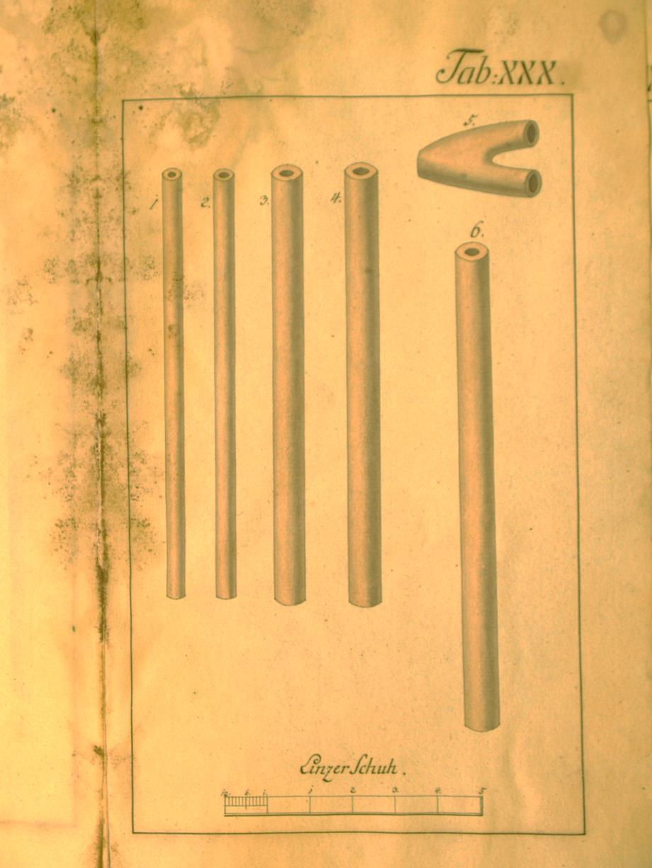
THE PIPELINE, THE SO CALLED "SULZSTRENN"
From 1595 to 1607 a 34 kilometre-long brine pipeline consisting of 13.000, about 4,5 m long wood pipes was constructed.
Notes:
45

Slide 46
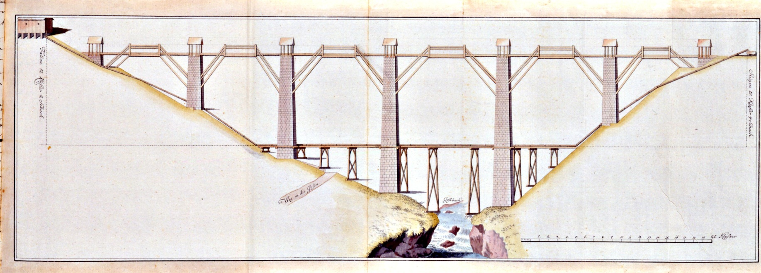
THE PIPELINE, THE SO CALLED "SULZSTRENN"
The most difficult section represented the crossing of the Gosau river. There the pipeline divided into three steel reinforced wooden pipes in which the brine flew down the right side of the valley and then crossed the river on a wooden construction.
Notes:
46

Slide 47
THE PIPELINE, THE SO CALLED "SULZSTRENN"
On the opposite side it climbed up the other slope of the valley under pressure. The only trace of this construction is the name of the place : Gosauzwang, “Zwang” being the German word for pressure.
Notes:
47

Slide 48
THE PIPELINE, THE SO CALLED "SULZSTRENN"
In 1756 it was necessary to build a third brine pipeline next to the two existing ones. During its construction a bridge on up to 30 metres high stone piers was built over the Gosau river, so that the pipeline could slope down evenly. Thus the enormous pressure in the pipes could be reduced a lot, which was a big problem for the technical possibilities at that time.
Notes:
48

Slide 49
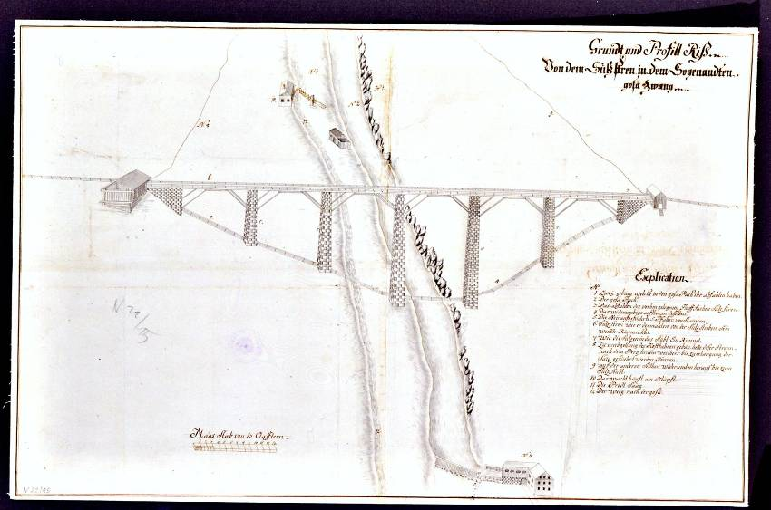
THE PIPELINE, THE SO CALLED "SULZSTRENN"
This brine pipeline, which was the first raw material pipeline of modern industrial times that connected two and more villages and the exemplary crossing of the valley of the Gosau river are of special importance. The good condition of the bridge piers and the use of the bridge in its original function, seems to guarantee its preservation for the near future.
Notes:
49

Slide 50
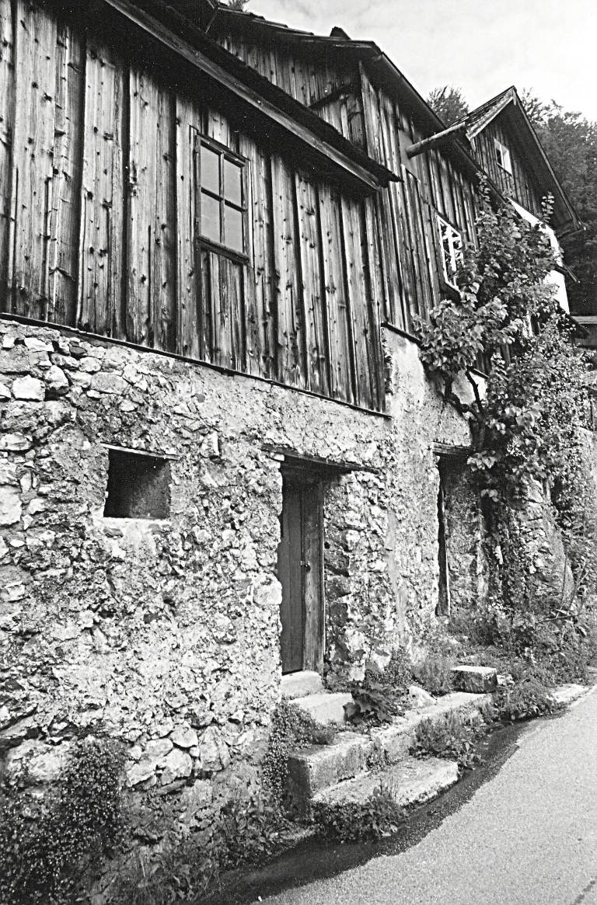
SUMMARY
The improvement of the quality of architectural culture in connection with the label “UNESCO World Cultural Heritage” is an important precondition for an urgently needed reorientation of tourism in Hallstatt. The mass tourism must become quality tourism.
To work out this concept the authenticity of the whole ensemble is essential.
Notes:
50

Slide 51
SUMMARY
The technically correct protection and the preservation of the remaining historic objects and structures can only be guaranteed by systematic architectural investigation. By editing historic plans and analysing the abstract criteria of structuring, my resarche is trying to make the first steps in this direction:
Notes:
51

Slide 52
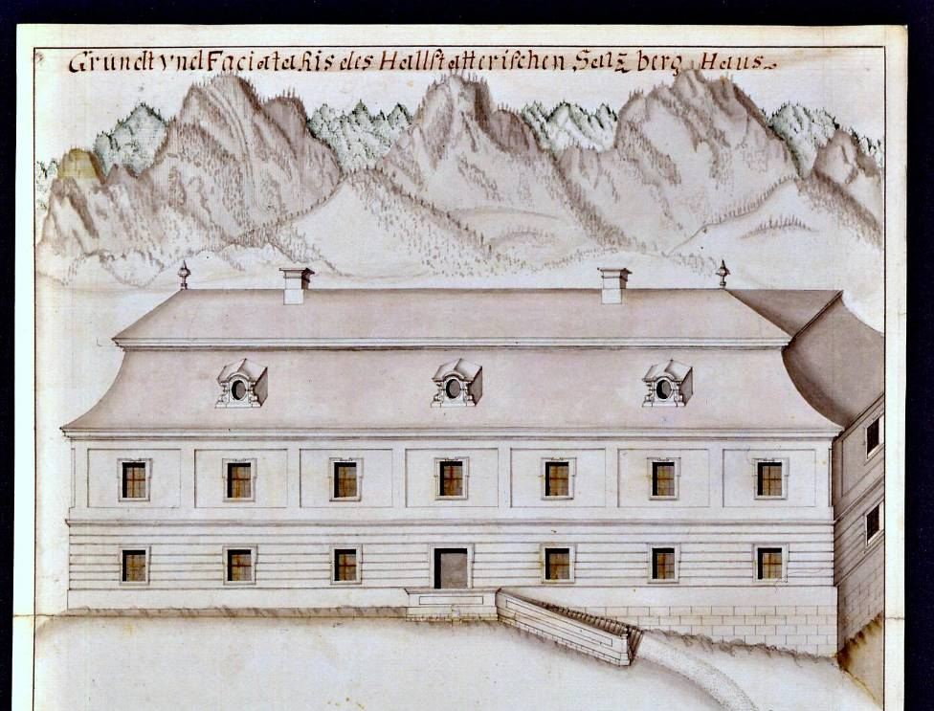
SUMMARY
• The unique combination of landscape and architecture in the central “Salzkammergut“ was essential for the admission to the UNESCO World Heritage list. The original buildings and architectural ensembles are vital for the regional cultural identity and are also of functional value for tourism.
Notes:
52

Slide 53
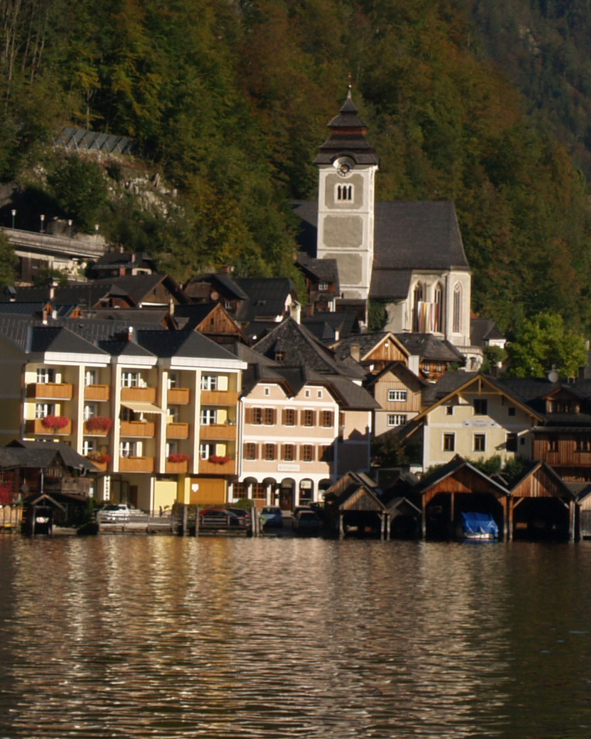
SUMMARY
• The contemporary architectural culture does not reach the quality of the original architectural objects, neither in the public or in the private sector.
So the cultural asset of the region is in a process of diminution, which logically results in negative consequences for the cultural identity in the whole area.
Notes:
53

Slide 54
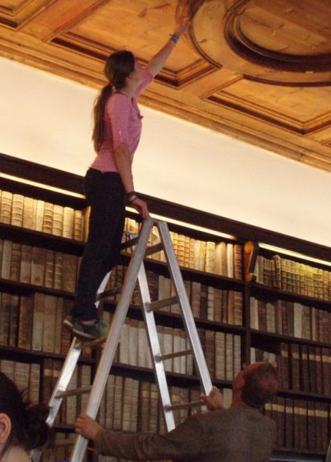
SUMMARY
• The technically correct protection and use of the remaining historic objects and structures can only be guaranteed by systematic architectural investigation. This is only possible if architectural investigation tries to approach public building contractors, the building and construction industries and also private builders.
Notes:
54

Slide 55
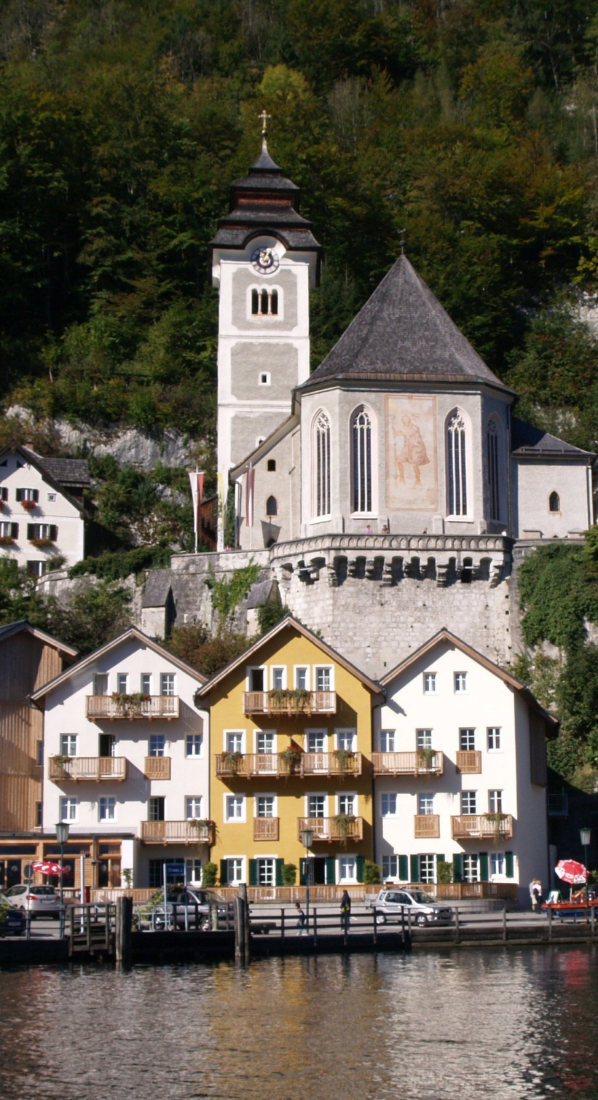
SUMMARY
The missing awareness of abstract criteria of structuring cannot only be compensated by investing great amounts of money in fake-buildings.
For years people have been trying to imitate historic buildings, but the results do not seem authentic.
Notes:
55

Slide 56
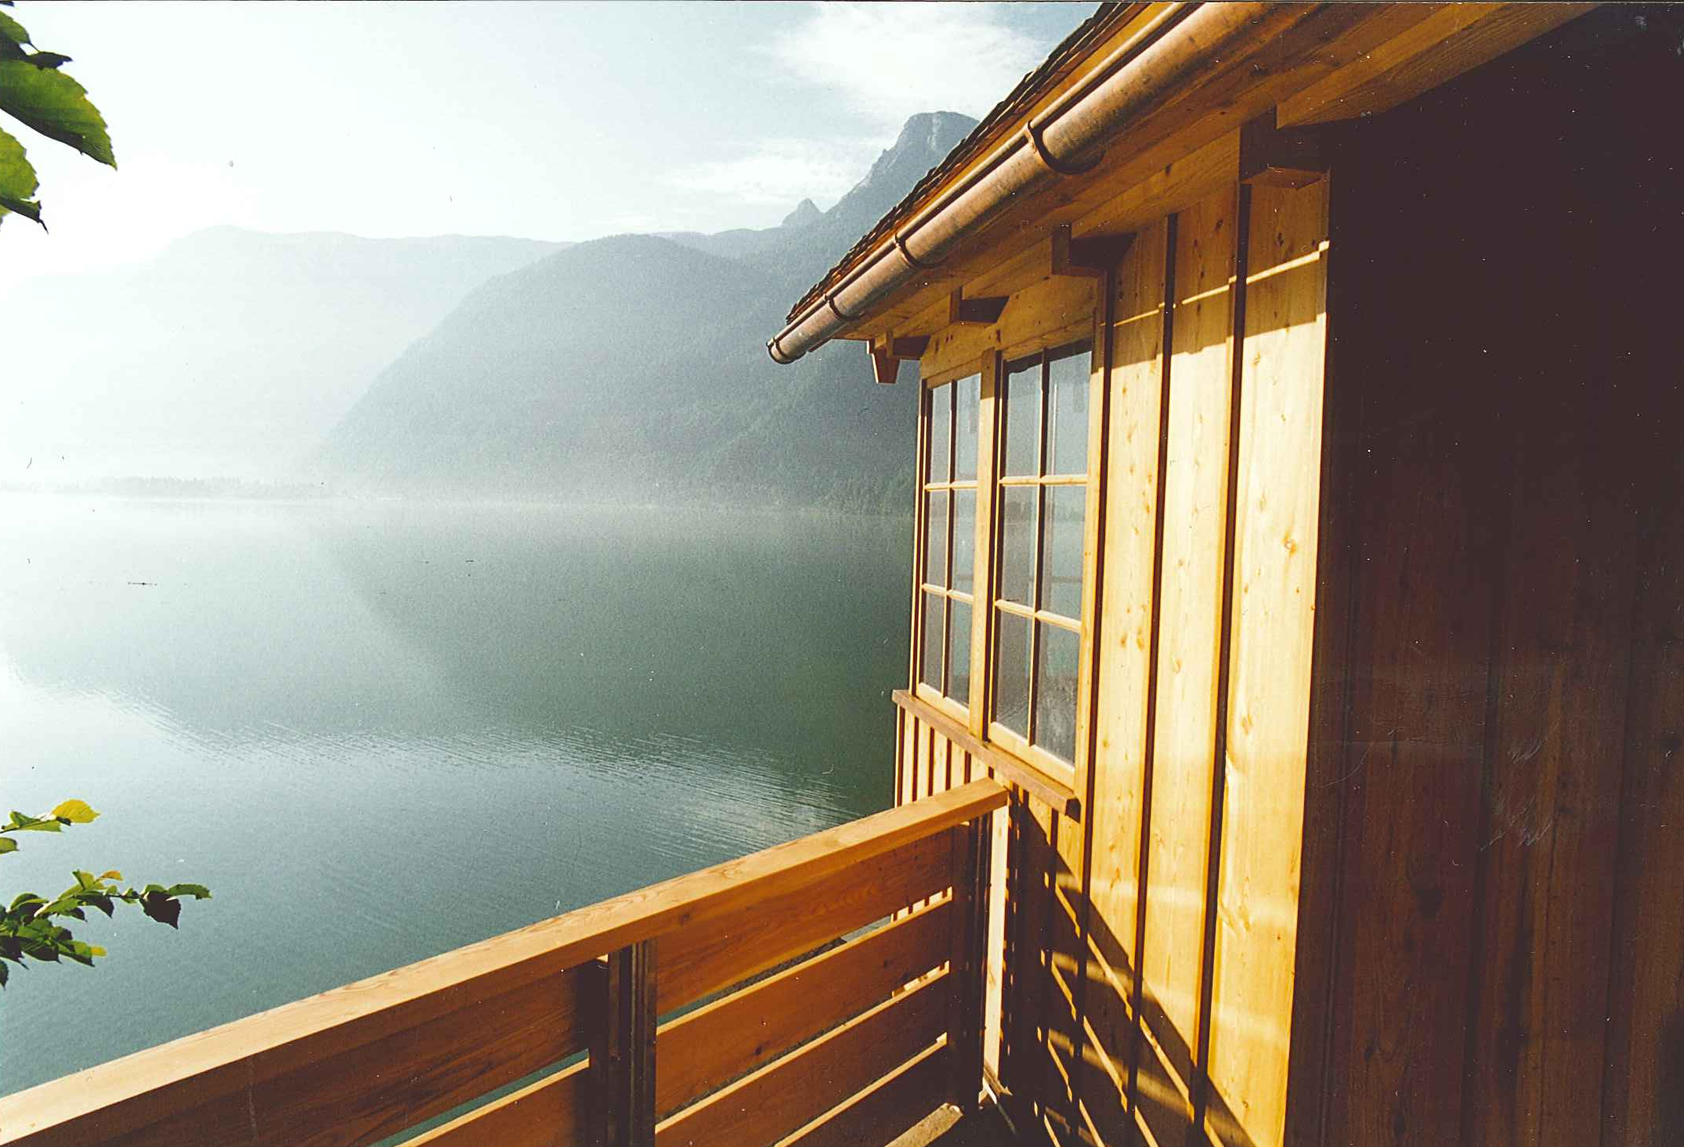
SUMMARY
Only the consequent translation of the results of architectural investigation into the architectural reality of the World Cultural Heritage region can create authenticity.
Notes:
56

Slide 57
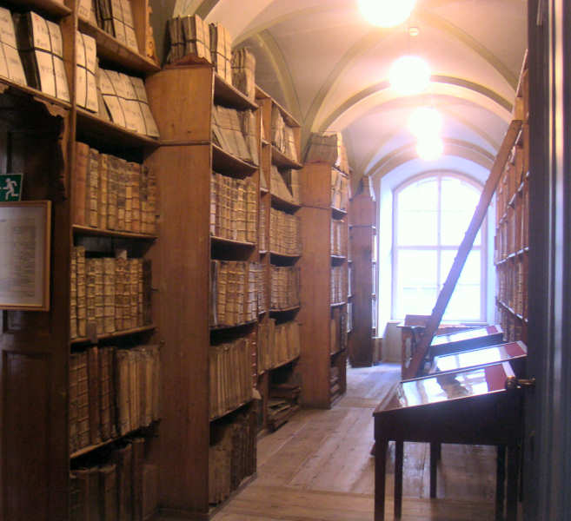
Thank you for your interest!
www.idam.at

